Slide 1
Object Oriented Programming
Introductory Concepts
Nikhil Panchal

Slide 2
What is it ?
Style of programming using “Objects” to design and build applications
Deals with compartmentalization of code
To have objects know how to handle its own part of the application. Nothing more, nothing less
Objects collaborate with each other to provide a holistic application (as opposed to Monolithic applications)
When done correctly leads to structured, modular code that’s easy to understand and manage
Notes:
Compartmentalization: Similar to how a corporation is split up into multiple divisions, where each division knows how to do its own job, with no knowledge of how the other divisions do theirs
Monolithic applications: Everything is one big massive program. Modular applications: The app is broken down into multiple components, each one handling its own thing.

Slide 3
Objects
Self contained component with
Properties (state: what it knows)
Methods (functions: what it can do)
Used to expose what this object can do to other objects in the application
Provide standardized access to the objects state
Ensures the actual implementation of the objects tasks are hidden: Other objects know what it can do, but not how it does it (Encapsulation)
Object can do one, and only one thing (Single Responsibility)
Application composed of multiple “type” of objects
Notes:
OOP Mimics a real, life representation of an application. Objects can be the nouns you find in real life
Car object: State: gas level, oil level, battery level, current speed

Slide 4
Class
Blueprint or Set of Instructions to build a specific type of object
Creates an Object “Instance”: Specific object built from a class
Examples
Recipe for Chocolate Cake
The Recipe: Class
The Chocolate Cake obtained from following the recipe: Instance, Object of type Chocolate Cake
Manufacturing Process for a Car
The Instructions: Class
The Car: Instance, Object of type Car
Used to create as many objects as required
Created objects are assigned to variables
Well designed classes lead to reusable, flexible and encapsulated code

Slide 5
Writing a Class
class ChocolateCake {
var numberOfCandles:int;
function ChocolateCake() { // Construtor }
function addCandleToCake():void { numberofCandles = numberOfCandles + 1
}
function getCandlesOnCake(): int {
return numberOfCandles;
}
}
var cake = new ChocolateCake();
cake.addCandleToCake();
alert(cake.getCandlesOnCake());
Notes:
Methods: used to interact with the created objects, to get or set state within the object
Fields: protected by the object. Represents state of the object. Only available if asked in a nice way.

Slide 6
Encapsulation
The object “hides” its internal data and the internal workings of its methods
Exposes a basic set of operations for other parts of the application to tell the object “WHAT” to do, without knowing “HOW” it does it
Benefits
Simplified interface to the outside world
Inner complexities of the object are hidden
Manage change
Enables you to localize changes
Promotes Reuse
Eg, Light Switch, Automobiles, JQuery UI Widgets
Notes:
Think about a light switch. In order to turn on the lights, you simply toggle the switch. You don’t need to be an electrician or understand anything about electricity to work the electrical system in a room.
An automobile is another good example. As long as you know how to use the gas and brake pedals, steering wheel, and ignition, you can drive. You don’t have to understand how the engine, or transmission, or electrical system works to drive a car.
Hides its complexity from other parts of the system

Slide 7
Managing Change
class CarEngine {
public function CarEngine() {}
private function engageChoke():void {}
private function disengageChoke():void {}
private function engageElectricSystem():void {}
private function powerSolenoid():void {}
private function provideFuel():void {}
private function provideSpark():void {}
public function start():void { // Offers a simplified operation to the outside
engageChoke();
engageElectricSystem();
powerSolenoid();
provideFuel();
provideSpark();
disengageChoke();
}
public function stop():void {} // Offers a simplified operation to the outside
}

Slide 8
Managing Change
class CarEngine {
public function CarEngine() {}
private function engageElectricSystem():void {}
private function powerComputer():void {}
private function powerSolenoid():void {}
private function provideFuel():void {}
private function provideSpark():void {}
public function start():void {
engageElectricSystem();
powerComputer();
powerSolenoid();
provideFuel();
provideSpark();
}
public function stop():void {}
}
Notes:
Code to start engine, previous slide, remains unchanged.

Slide 9
Managing Change
var carEngine = new CarEngine();
carEngine.start();
carEngine.stop();
No change to the code that uses the object
Notes:
Code to start engine, previous slide, remains unchanged.

Slide 10
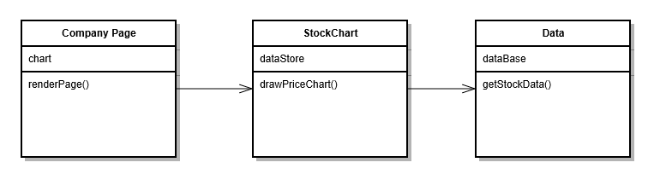
Managing Change
As long as the exposed operations of the object remains the same, changes made to the internal workings of the object have no impact to the rest of the system
Important when you work across teams
Comes into play when you upgrade component libraries (JQuery)
The exposed set of operations called the “Interface”
Notes:
Code to start the engine. Unmodified, even if the implementation of CarEngine changes.
Ex. Think of two teams working to produce a stock chart application. One team handles data retrieval, the other handles the graphical rendering of the data. Each communicates with the other using the public interface. Which allows the data team to fix bugs, change underlying data sources, without having any impact to the graphical part

Slide 11
Interfaces
The operations (methods) that the object exposes to the outside world
Can be extracted out as an entity in itself
Interface CarEngine {
public function start();
public function stop();
}
A Class is said to “Implement” the Interface
Eg. Web Browsers
Specifications decided by the W3C
Implementations provided by different corporations
IE, Chrome, Firefox, Safari
Good practice to code to the interface
Promotes application extensibility through Polymorphism
Notes:
API: Application Programmer Interface.

Slide 12
Polymorphism
Many forms
Multiple types of objects can work in the same situation, as long as they offer the same interface
Eg. To write on paper you can use a Pen, a Pencil, a Crayon
These are different objects that implement the same interface
They all offer the same interface to be used to write
So the directions to use each of them are the same

Slide 13
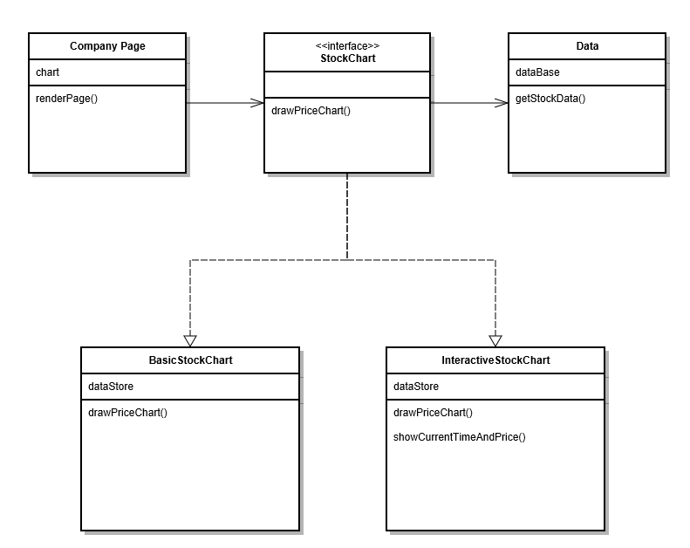
Polymorphism

Slide 14
Trading Engine
Objective
Design the outline an application that places trades based on a variety of trading strategies
The application needs to be easily maintainable
Should be able to add and remove Strategies with minimal effort
Individual Strategies should be modified without affecting the rest of the application
Any Strategy can be executed on demand
An individual Strategy may use other component Strategies for its own execution

Slide 15
Trading Engine
Split into two main components
The Engine
Would hold all of the registered Trading Strategies
Would pick up the desired Strategy and execute it by calling its Interface function
Would have no knowledge of the inner workings of the individual Strategies
The Trading Strategies
Would each implement a common Interface that would be exposed to the Engine or other Strategies
Could be an individual Stand alone strategy or a compound strategy that uses other sub-strategies
Notes:
Introduce individual Trading Strategies: Covered Calls, Straddles, Butterfllies etc.

Slide 16
Trading Engine
The Engine
Class TradingEngine {
private stratStore: TradingStrategy[];
public function TradingEngine() {}
public function addStrategy(TradingStrategy:strat): void {}
public function executeStrategy(stratName:String): void {
var strat:TradingStrategy = stratStore.get(stratName);
strat.execute();
}
}

Slide 17
Trading Engine
The Strategies
Interface TradingStrategy {
public function execute();
}
Needed to work like “plugins”, where one could be added or removed without affecting others

Slide 18
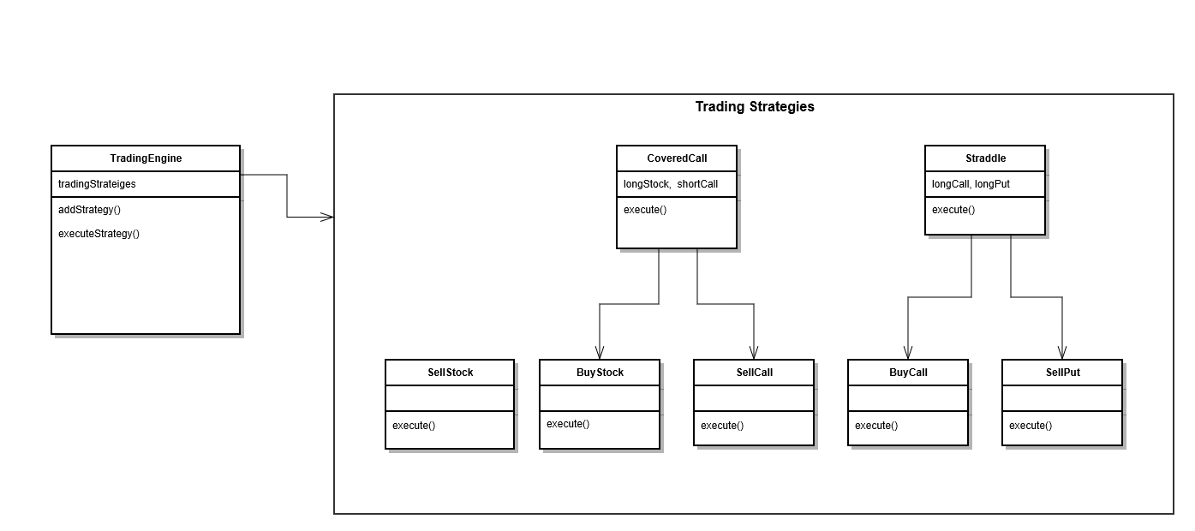
Trading Engine

Slide 19
Trading Engine
The Simple Strategies
Class LongStockStrategy implements TradingStrategy {
public function execute() {
// Buy an Equity Security
}
}
Class ShortStockStrategy implements TradingStrategy {
public function execute() {
// Sell an Equity Security
}
}
Class LongCallStrategy implements TradingStrategy {
public function execute() {
// Buy an Equity Call Option
}
}
Class ShortCallStrategy implements TradingStrategy {
public function execute() {
// Sell an Equity Call Security
}
}

Slide 20
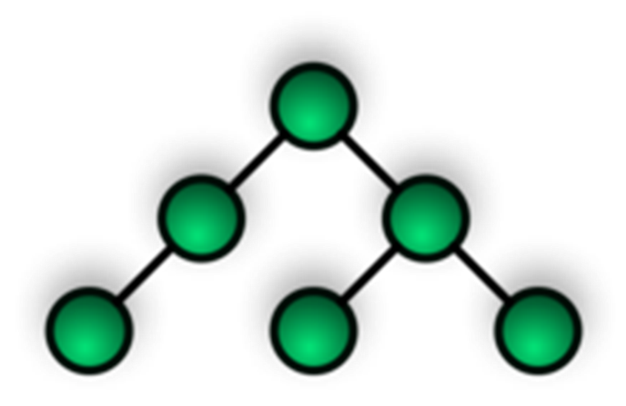
Trading Engine
The Compound Strategies
Class CoveredCall implements TradingStrategy {
var longStock:TradingStrategy
var shortCall:TradingStrategy
public function CoveredCall() {
longStock = new LongStockStrategy();
shortCall = new ShortCallStrategy();
}
public function execute() {
// Go long a stock
longStock.execute();
// Short a call option
shortCall.execute();
}
}

Slide 21
Trading Engine
The Compound Strategies
Class StraddleStrategy implements TradingStrategy {
var longPut:TradingStrategy
var longCall:TradingStrategy
public function CoveredCall() {
longPut = new LongPutStrategy();
longCall = new LongCallStrategy();
}
public function execute() {
// Go long a Put
longPut.execute();
// Go long a Call
longCall.execute();
}
}
Notes:
Block diagram

Slide 22

Trading Engine
Modularity
Application split into smaller components/objects, each handling its own responsibility
Objects have no knowledge of each others implementation
Extensibility (Reliable)
New Strategies could be added, Individual strategies could be modified without affecting others. No need to test out entire app
Reuse
Strategies written as independent blocks of code that could be combined in various ways to create complex strategies without much new coding
Significantly reduced Time To Market

Slide 23
Questions

